Slide 1
Quantum Gates in Quantum Computing
Piyush Kumar Karn (252IS026) Samyak Gedam (252IS032)

Slide 2
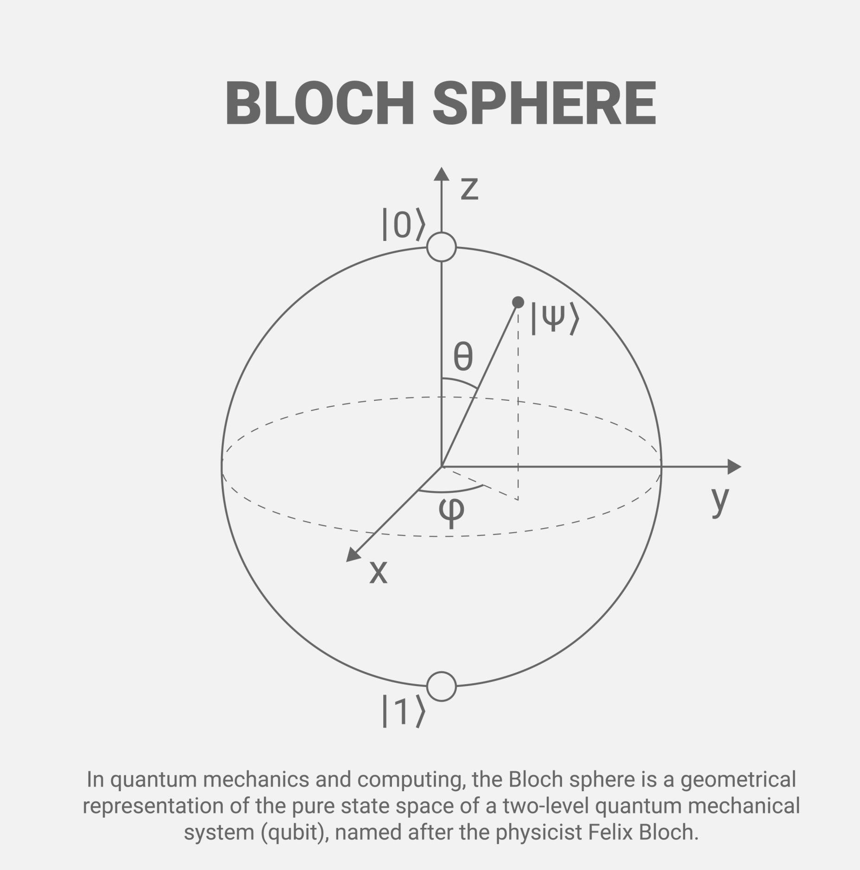

What is Quantum Computing?
Quantum computing is a computing paradigm that uses qubits and principles of quantum mechanics to process information.

Slide 3
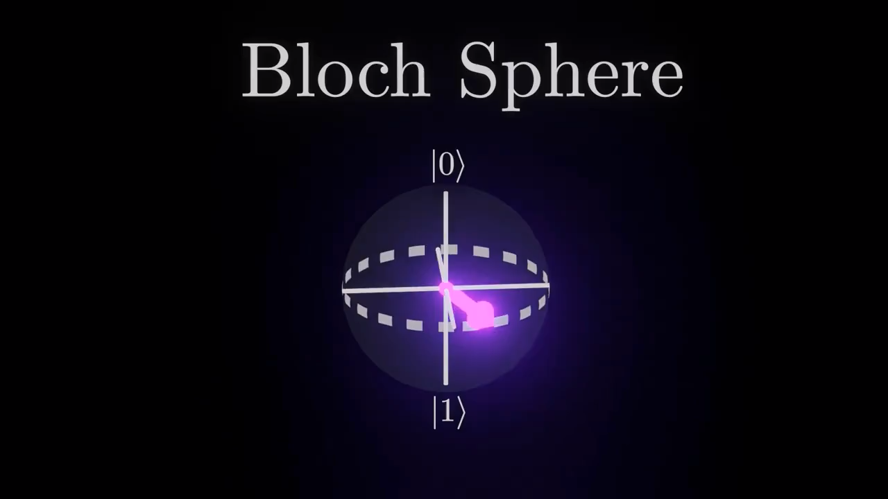
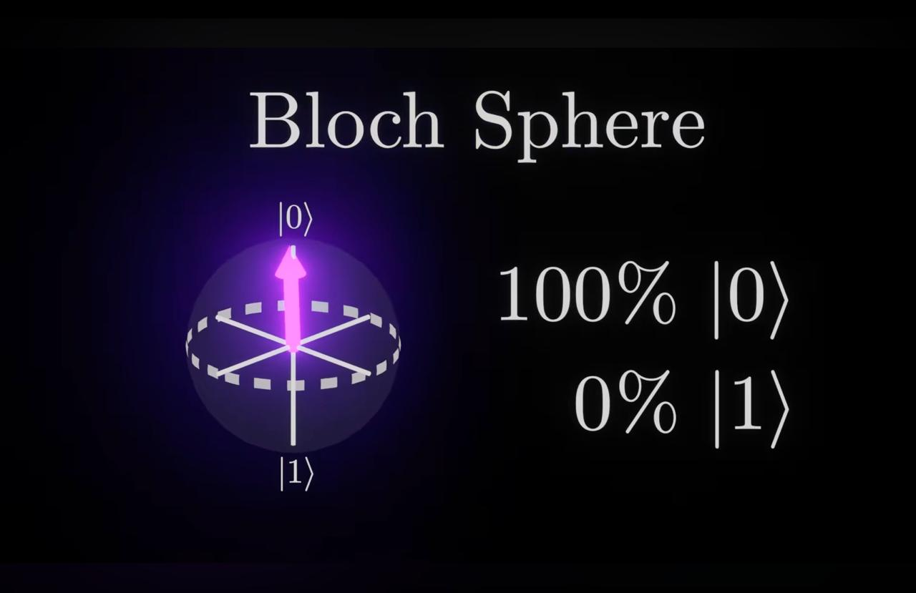
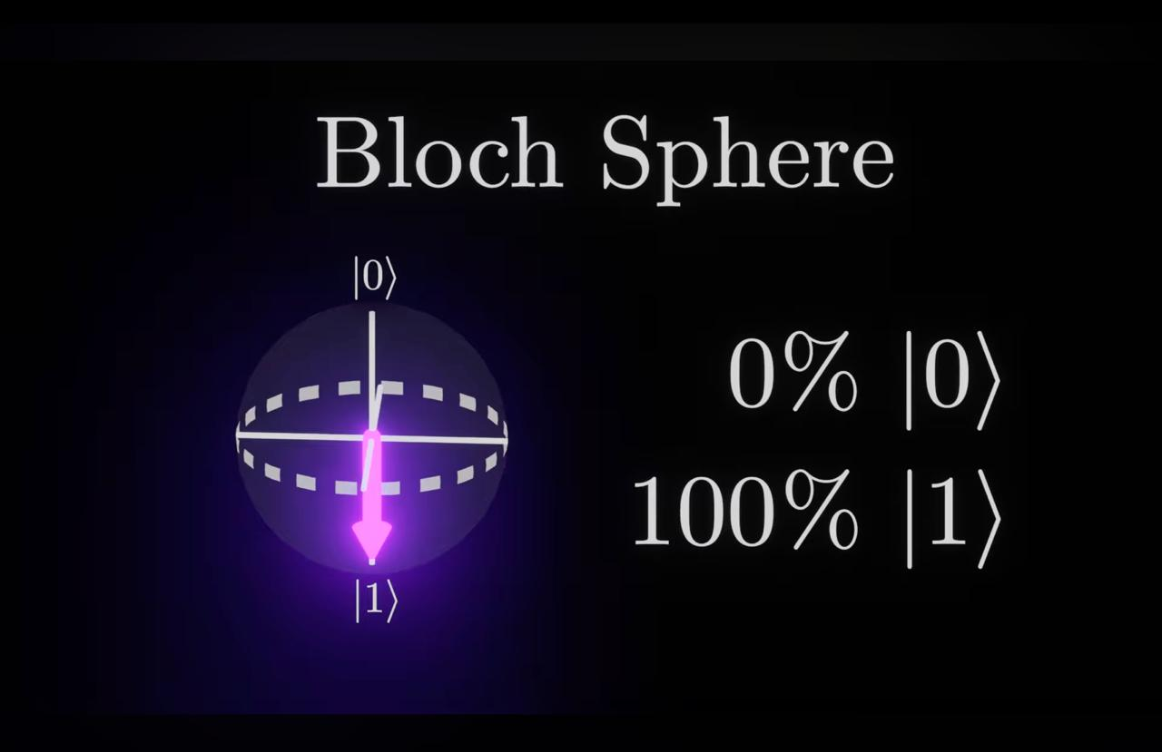

Slide 4

Why Do We Need Quantum Gates?
Role of Quantum Gates
Manipulate qubit states
Perform quantum operations
Build quantum circuits
Enable quantum algorithms
In classical computing, logic gates like AND and OR manipulate bits.
Similarly, in quantum computing, quantum gates manipulate qubits.
However, instead of simply flipping between 0 and 1, quantum gates transform probability amplitudes using unitary matrices.

Slide 5


Properties of Quantum Gates
Reversibility
All quantum gates are reversible
No information is lost
Every gate has an inverse
4. Composability
Quantum gates can be combined
Form quantum circuits
Enable complex quantum algorithms

Slide 6
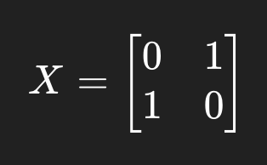
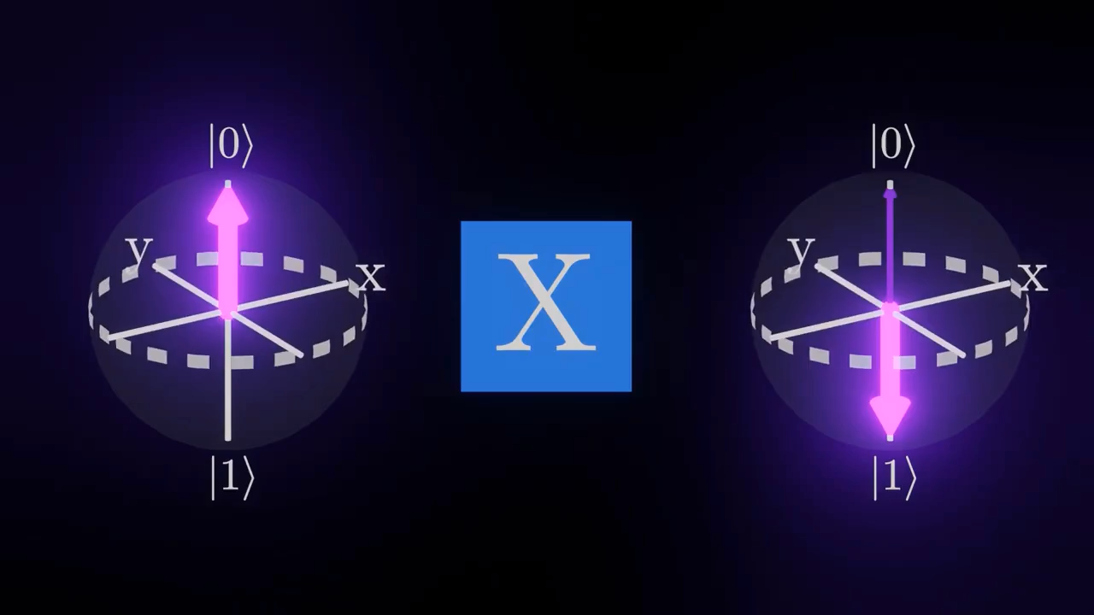
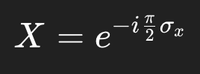
Single Qubit Gates: Pauli-X Gate (σₓ)
Pauli-X (Bit Flip)
Symbol: X
Also written as: σx
Circuit symbol: ⊕ (NOT symbol in quantum circuits)
Rotation Angle
Equivalent to: Rotation by π radians (180°) around X-axis on Bloch sphere.
Action on Basis States
X|0⟩= |1⟩ X|1⟩= |0⟩ Acts like classical NOT gate.

Slide 7
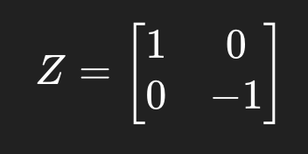
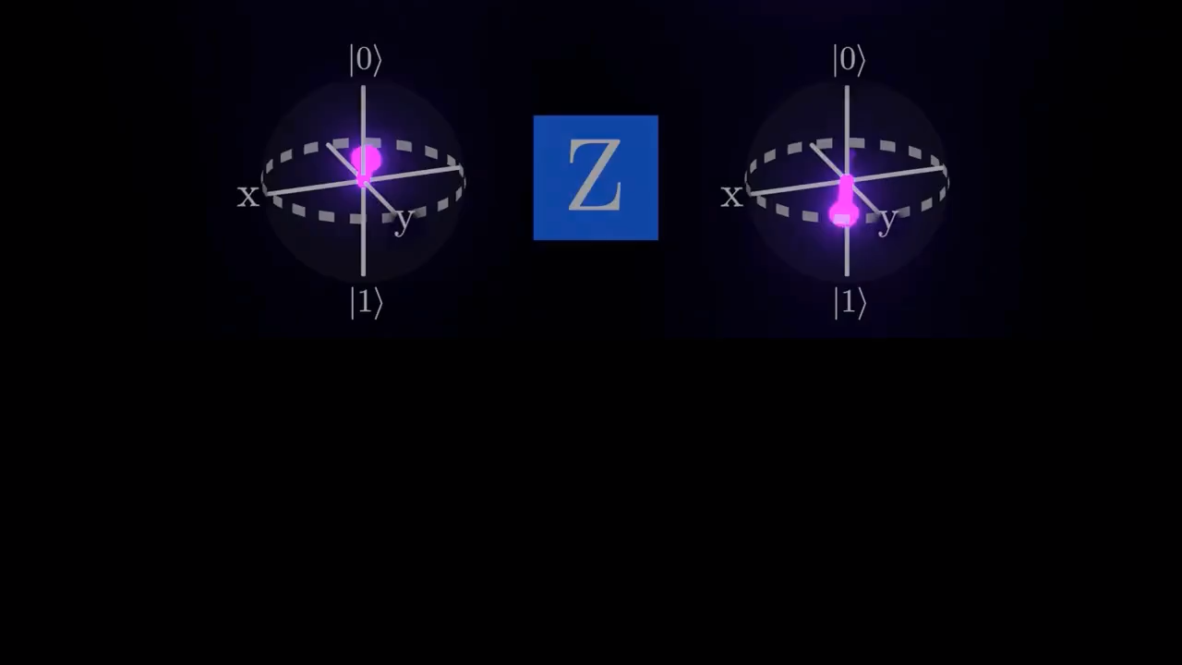
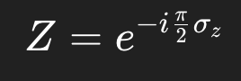
Single Qubit Gates: Pauli-Z Gate (σ_{z})​
Action on Basis States
Z|0⟩= |0⟩ Z|1⟩= −|1⟩ This is a phase flip gate.
(Changes phase, not value)
Pauli-Z (Phase Flip)
Symbol: Z
Also written as: σz
Rotation Angle
Equivalent to: Rotation by π radians (180°) around Z-axis on Bloch sphere.

Slide 8
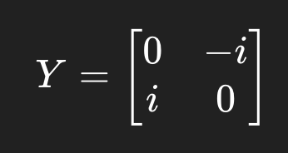
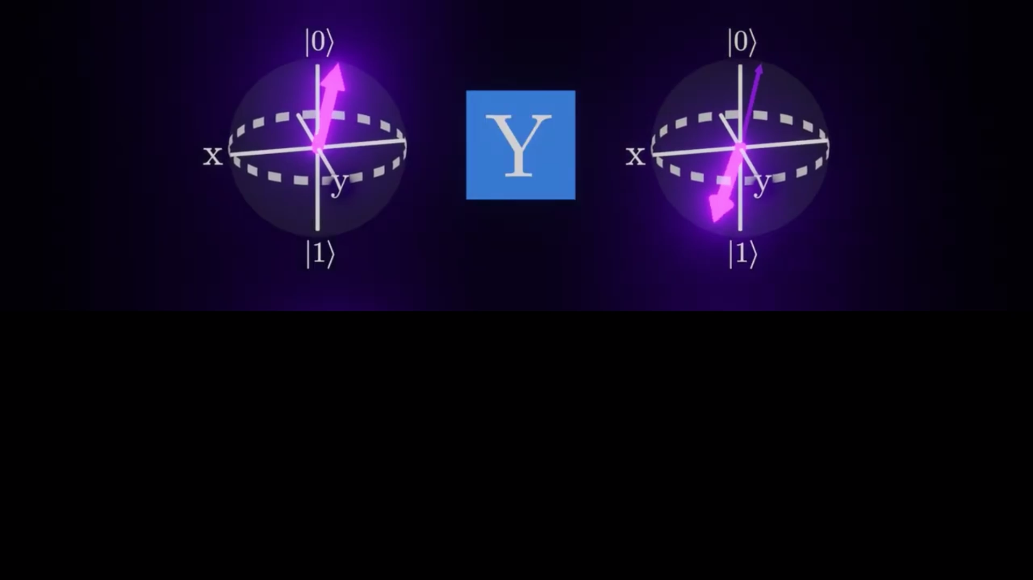
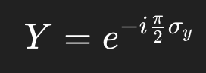
Single Qubit Gates: Pauli-Y Gate (σᵧ)
Pauli-Y (Bit + Phase Flip)
Symbol: Y
Also written as: σy​
Action on Basis States
Y∣0⟩= i |1⟩ Y∣1⟩= −i |0⟩ Flips state + adds phase factor.
Rotation Angle
Equivalent to: Rotation by π radians (180°) around Y-axis on Bloch sphere.

Slide 9
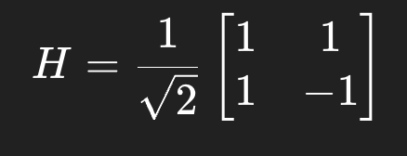
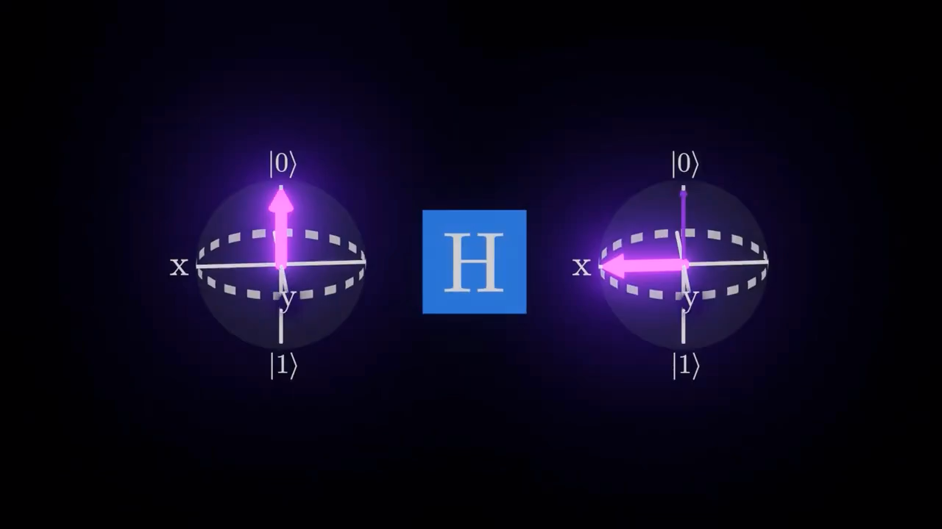
Single Qubit Gates: Hadamard Gate (H)
The Hadamard gate (H) is one of the most important single-qubit quantum gates.
It is used to:
Create superposition
Enable quantum parallelism
Convert between computational and diagonal
basis
Initiate interference in quantum algorithms
Matrix Representation
Symbol: H
Circuit notation: A box labeled H

Slide 10
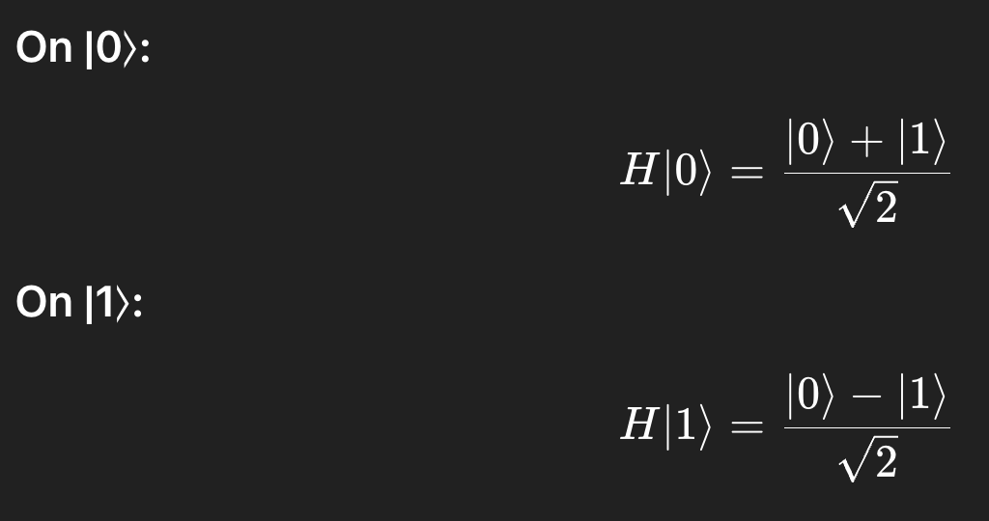
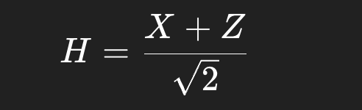

Single Qubit Gates: Hadamard Gate (H)
Action on Basis States
Rotation Interpretation
Although H is not purely a single-axis rotation, it can be expressed as:
Geometric interpretation:
Equivalent to rotation by π radians (180°) about axis:
This axis lies halfway between X and Z axes on Bloch sphere.
Interpretation:
Creates equal superposition
Introduces relative phase difference
Enables interference

Slide 11
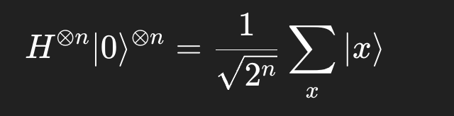
Single Qubit Gates: Hadamard Gate (H)
Hadamard gate is essential in:
Quantum Parallelism
Applying H to n qubits:
Creates uniform superposition of all basis states.
Shor’s Algorithm
Used in quantum Fourier transform initialization.
Grover’s Algorithm
Used in diffusion operator.
Quantum Teleportation
Used in Bell state preparation.
On Bloch sphere:
|0⟩ (north pole)
After H → moves to equator (|+⟩ state)
Rotates state from Z-axis to X-axis
Effectively:
Maps Z-basis states to X-basis states

Slide 12
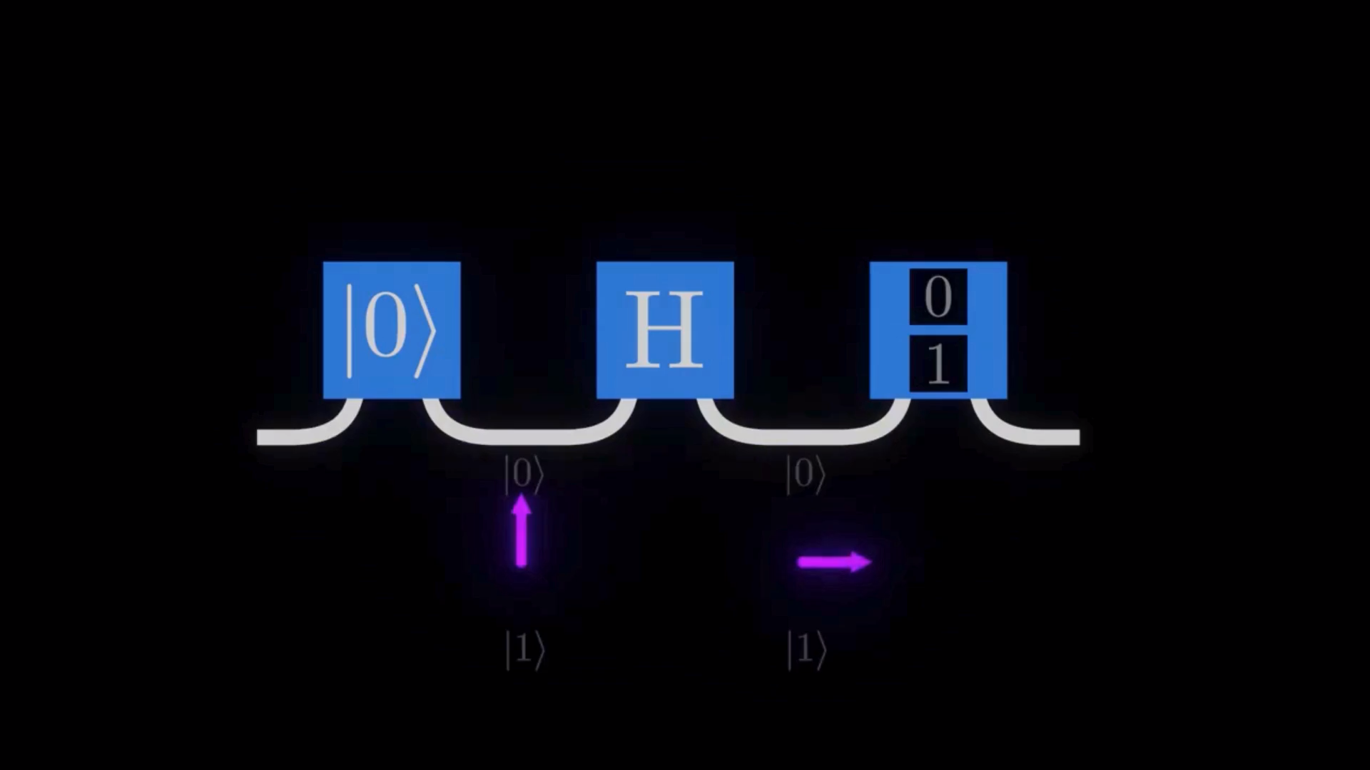
Single Qubit Gates: Hadamard Gate (H)

Slide 13
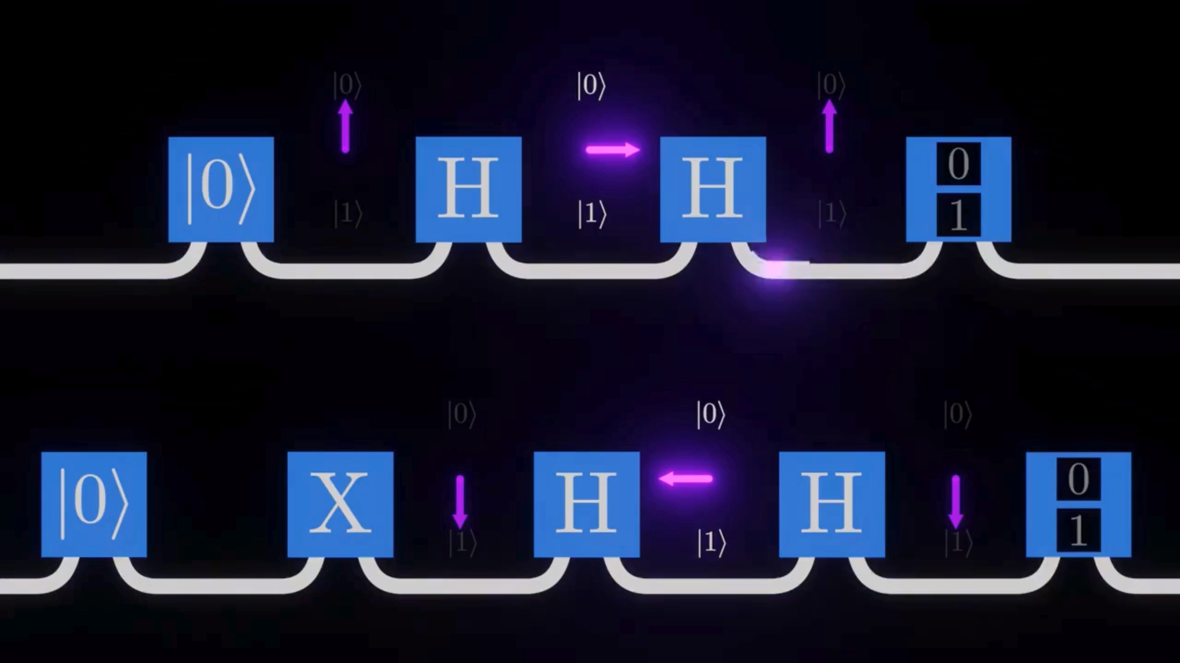
Single Qubit Gates: Hadamard Gate (H)

Slide 14
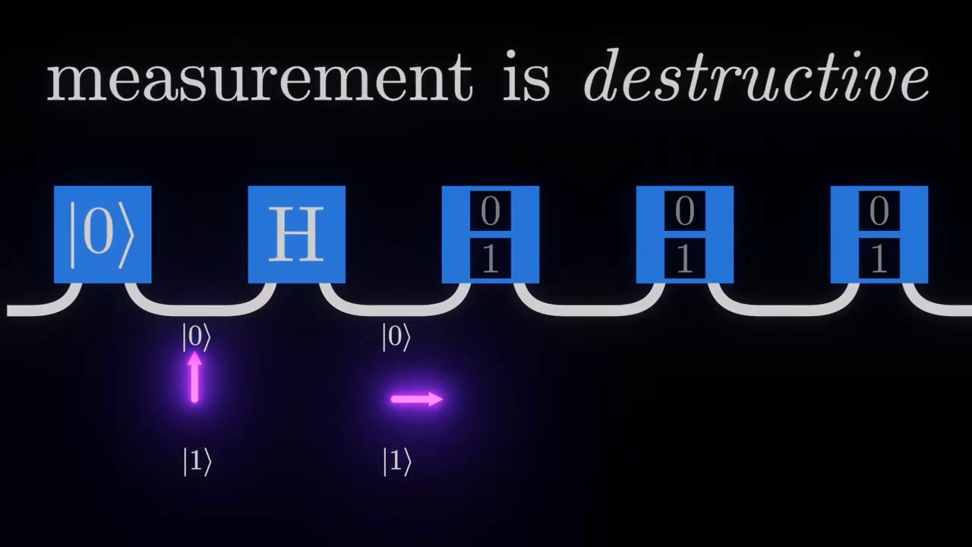
Collapsing a Superposition

Slide 15
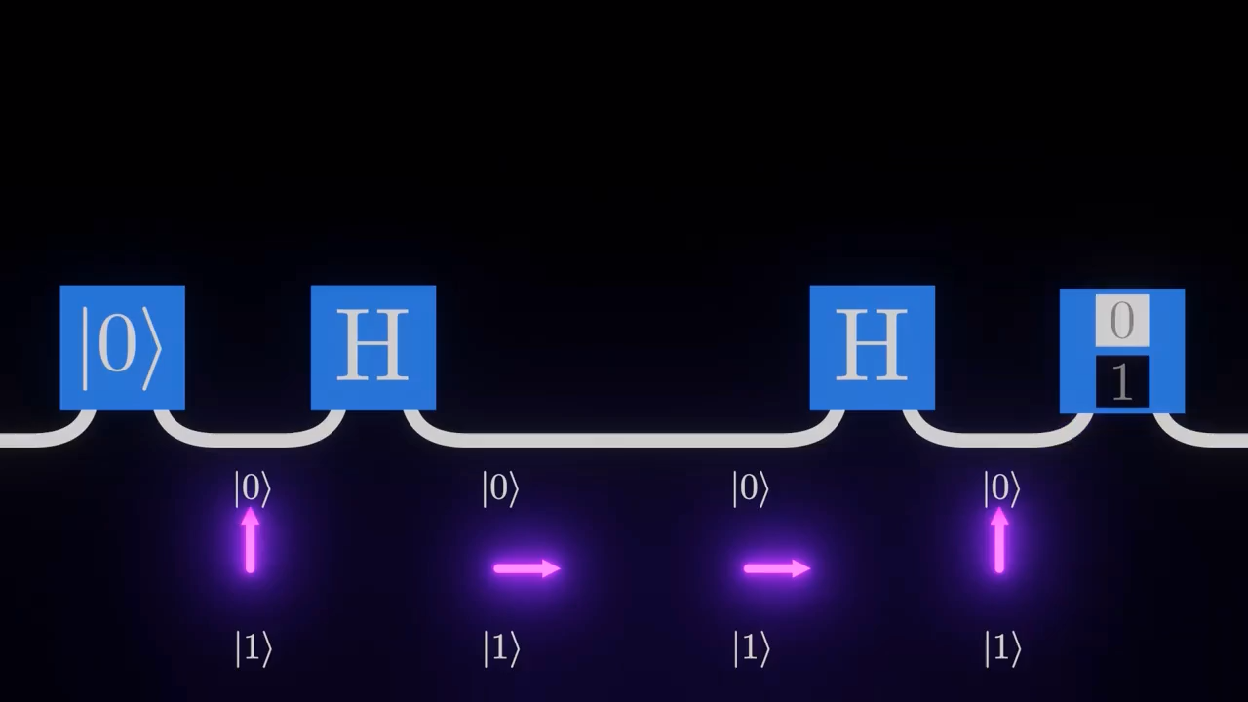
Putting a Measing Gate b/w two H-Gates

Slide 16
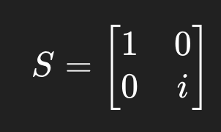
Single Qubit Gates: Phase Gates (S and T)
The S Gate (The Phase Gate)
Definition: Often called the √Z gate because applying it twice results in a Pauli-Z gate.
Action: Rotates the qubit state by 𝜋/2 (90°) around the Z-axis on the Bloch Sphere.
Effect on States:
|0⟩ to |0⟩ (No change)
|1⟩ to i|1⟩ (Adds a imaginary phase)
The Matrix:

Slide 17
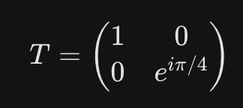
Single Qubit Gates: Phase Gates (S and T)
The T Gate (The 𝜋/8 Gate)
Definition: A fundamental "non-Clifford" gate. It is the most critical gate for achieving Universal Quantum Computation.
Known as the "𝜋/8 gate" (due to a different mathematical convention).
Action: Rotates the qubit state by 𝜋/4 (45°) around the Z-axis.
Effect on States:
|0⟩ to |0⟩
|1⟩ to e^{i𝜋/4}|1⟩
The Matrix:

Slide 18
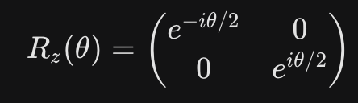
Single Qubit Gates:Rotation Gates (R_{x}(θ), R_{y}(θ), R_{z}(θ))
Explanation: These are generalized gates that allow rotation by any arbitrary angle θ
General Formula (R_{z} example):
Key Features
Continuous parameter
Infinite possible gates
Generate all single-qubit unitaries
Use Case: Essential for fine-tuning quantum algorithms like VQE or QAOA.

Slide 19
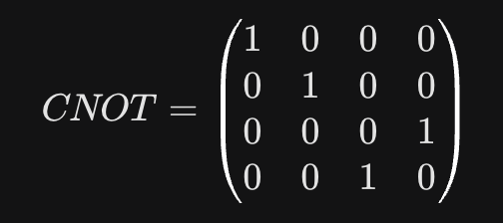
Multi-Qubit Gates: The CNOT Gate
Full Name: Controlled-NOT Gate.
Logic: Uses two qubits (Control and Target). If the Control is |1⟩ , it flips the Target.
Significance: This gate creates Entanglement.
Symbol: A small dot (control) connected by a vertical line to an X-gate (target).
The Matrix:

Slide 20
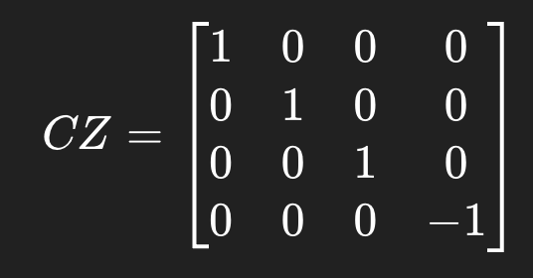
Multi-Qubit Gates: (CZ and SWAP)
Full Name: CZ (Controlled-Z)
Logic: Flips the phase of the target qubit only if the control qubit is |1⟩
Significance: Applies Z gate if both qubits = 1.
Key Feature: Phase entangling gate.
The Matrix:

Slide 21
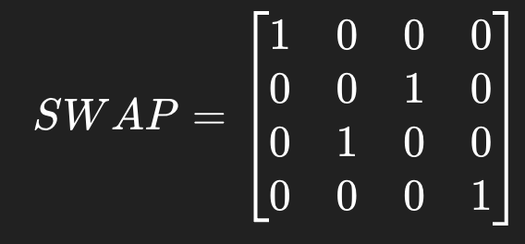
Multi-Qubit Gates: (CZ and SWAP)
Full Name: SWAP Gate
Logic: Exchanges the states of two qubits.
Significance: Useful for moving information across a quantum chip where qubits aren't all connected.
Visual: Show the SWAP symbol (two "x" marks connected by a line).
The Matrix:

Slide 22
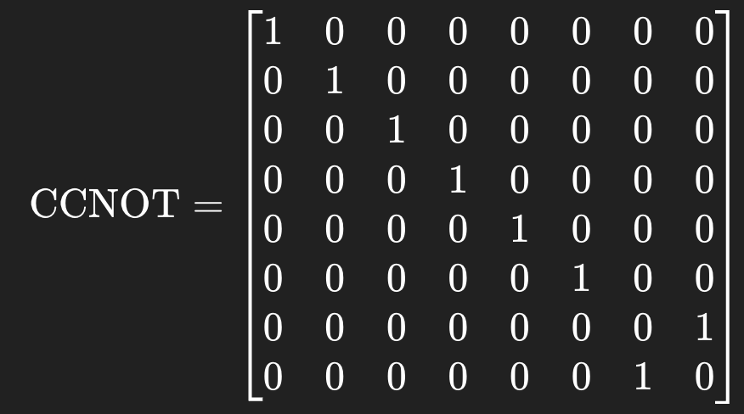
Multi Qubit State: Toffoli Gate (CCNOT – Controlled Controlled NOT)
Definition: The Toffoli gate is a three-qubit reversible quantum gate that flips the third (target) qubit only if both control qubits are 1.
Also called: CCNOTOT
Operation Rule:
Let qubits be:
|a,b,c⟩ Then: |a,b,c⟩ → | a,b,c ⊕ (a⋅b) ⟩
Meaning:
If a=1 AND b=1 → flip c
Otherwise → no change
It swaps only the last two states: |110⟩ ↔ |111⟩
Matrix Representation:

Slide 23
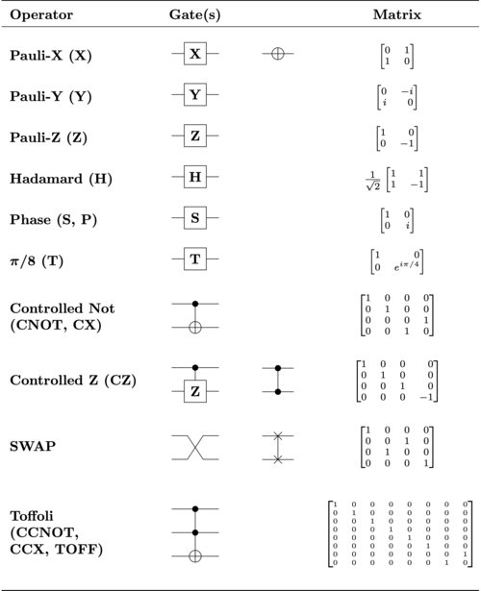
Common Quantum Gates with Circuit Symbols and Matrix Representations

Slide 24
Thank You!

